Slide 1
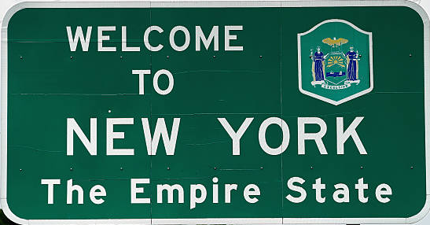
New York EV Rebate: Can We Do better?
Metis Business Proposal Project by Maxwell Wood

Slide 2

Client Information
New York State Energy Research and Development Authority(NYSERDA)
Public Benefit Corporation
Mission: To Help New Yorkers:
Increase Energy Efficiency
Save Money
Use Renewable Energy
Reduce Reliance on Fossil Fuels

Slide 3
Rebate Program
In 2017 NYSERDA launched an electric vehicle rebate program intended to help grow sales of electric vehicles
The rebate amount was based on single charge range:
Greater than 200 miles: $2,000 off
40 to 199 miles: $1,000 off
Less than 40 miles: $500 off
Greater than $42,000 MSRP: $500 off
*From NYDMV vehicle registrations

Slide 4
Is Range the Right Target?
Larger ranges in vehicles require larger batteries
This adds weight to vehicles
Extra weight Can mean lower vehicle efficiency

Slide 5
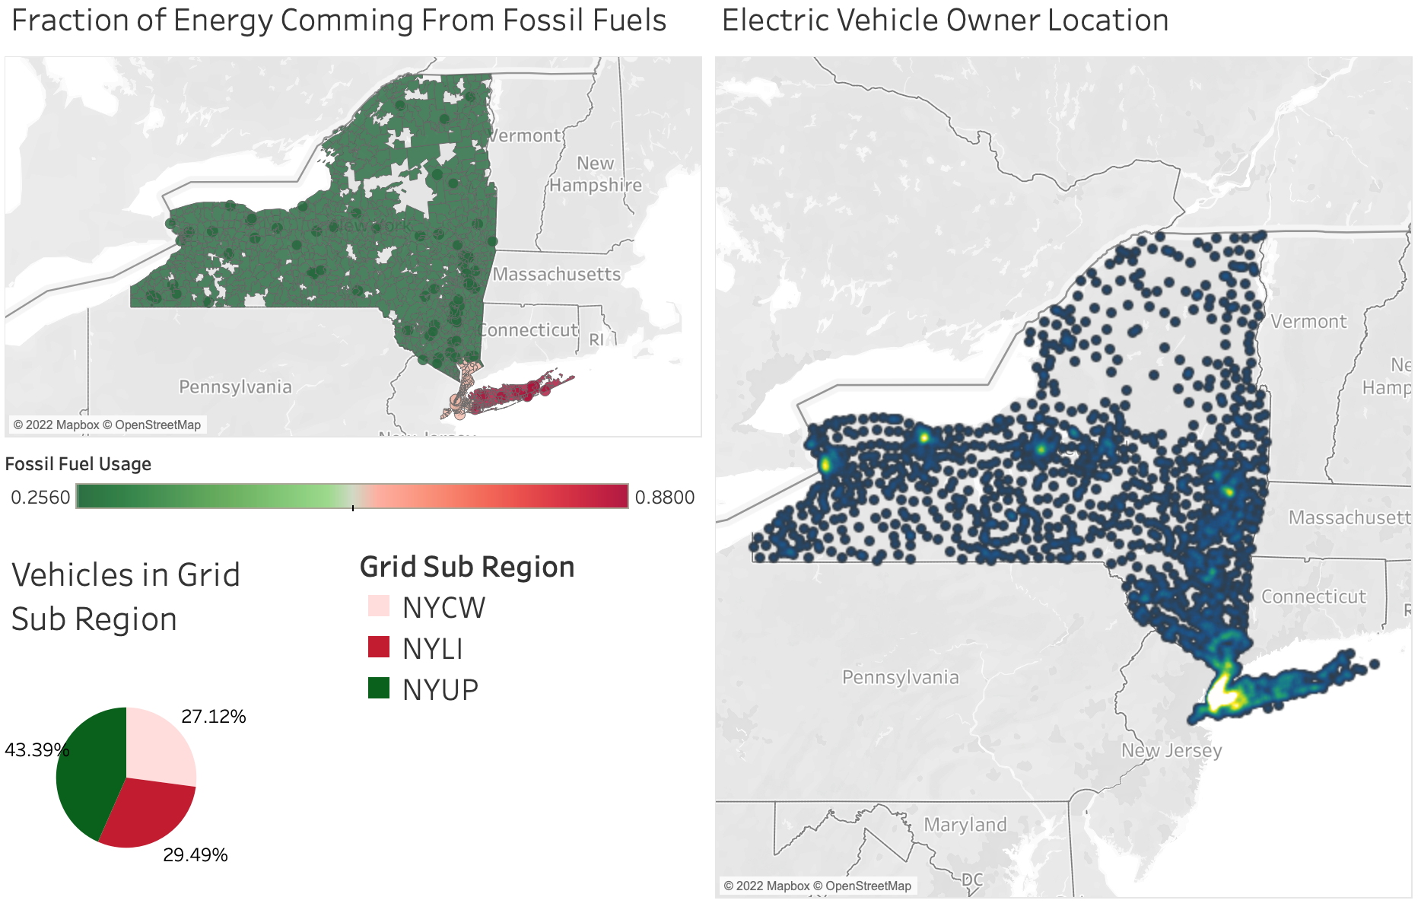
New York’s Energy is Still Far from Carbon Free

Slide 6
Problem and Impact
Problem:
New York’s EV rebate doesn’t appear to encourage more efficient vehicles
Impact Hypothesis:
Knowing the impact the rebate has on

Slide 7
Rebate, Range, and Efficiency Correlations
*Data from NYSERDA showing all electric vehicles sold in New York since the introduction of the rebate bellow $42,000

